Slide 1

Project Management
~ HOMEWORK SOLUTION ~
By: Prof. Y. Peter Chiu

Slide 2
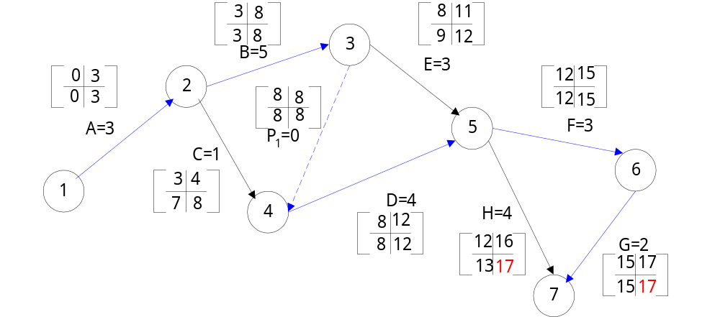
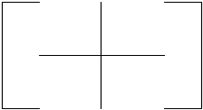
# 3
(a)
(b)
CP => A → B → D → F→ G (17)

Slide 3
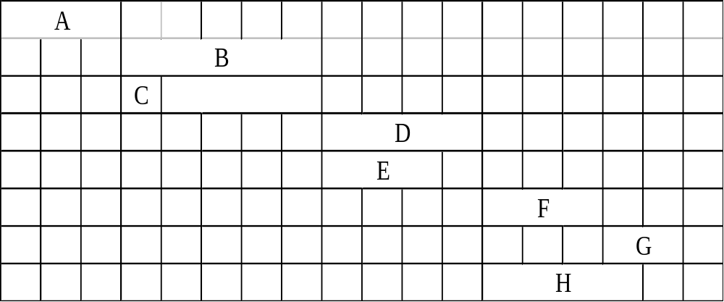

# 3
(c)
A
B
C
D
E
F
H
G
0
1
2
3
4
5
6
7
8
9
10
11
12
13
14
15
16
17
18
=> Where
is not needed for solution ,
but it is the slack time.

Slide 4
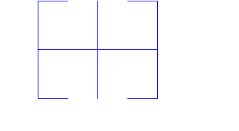
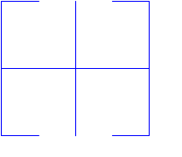
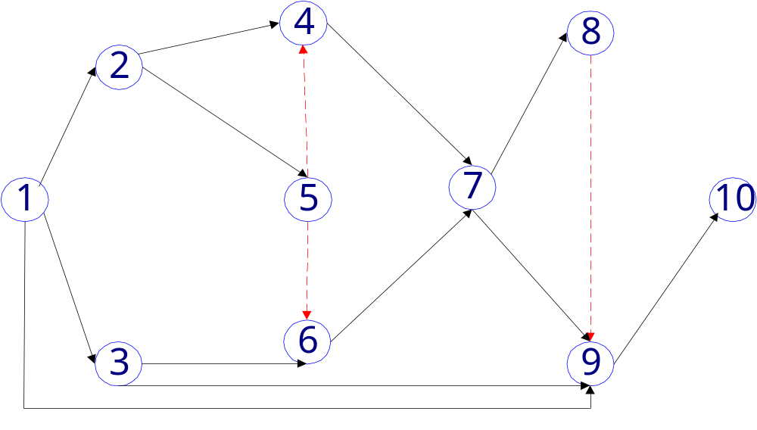


# 4
3
8
7
12
8
9
C=5
12
13
0
3
3
7
1
4
F=1
4
8
7
7
16
16
D=4
12
12
H=3
A=3
17
17
P1=0
7
7
13
16
P3=0
*
*
0
2
8
8
8
12
14
17
0
2
*
P2=0
8
13
2
8
I=4
J=4
B=2
G=5
2
7
13
17
2
8
*
12
17
13
17
*
17
21
E=6
K=5
17
21

Slide 5
# 4
(a)
(b)
A-C-F-H-J
A-C-F-I-J
A-D-F-H-J
A-D-F-I-J
A-D-G-H-J
A-D-G-I-J
B-E-G-H-J
B-E-G-I-J
B-K-J
16
17
15
16
19
20
20
21
11
14
A －
B －
C A
D A
E B
F C，D
G D，E
H F，G
I F，G
J H，I，K，L
K B
L －
*
L-J

Slide 6
# 4
(c)
Activities
ti
ESi
SFi
LSi
LFi
Slack
A
B
C
D
E
F
G
H
I
J
K
L
3
2
5
4
6
1
5
3
4
4
5
10
0
0
3
3
2
8
8
13
13
17
2
0
3
2
8
7
8
9
13
16
17
21
7
10
1
0
7
4
2
12
8
14
13
17
12
7
4
2
12
8
8
13
13
17
17
21
17
17
1
0
4
1
0
4
0
1
0
0
10
7
‧
‧
‧
‧
‧
CP= B-E-G-I-J

Slide 7
# 5
(a)
Immediate
Predecessor
Activities
A
B
C
D
E
F
G
H
I
－
－
A
B
D
A，E
D
C，F
C，F，G

Slide 8
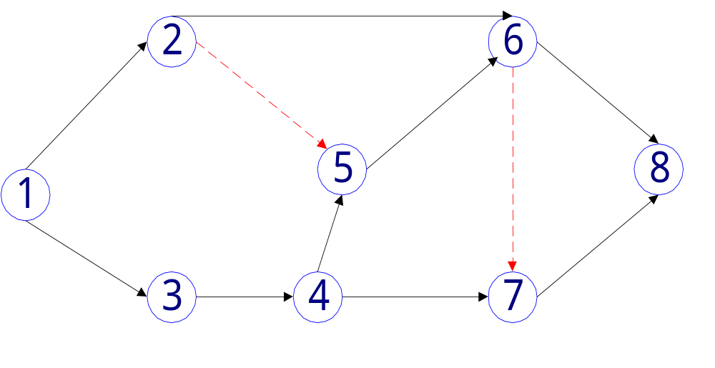
# 5
(b)
C
A
H
F
P₁
P₂
E
B
I
D
G

Slide 9
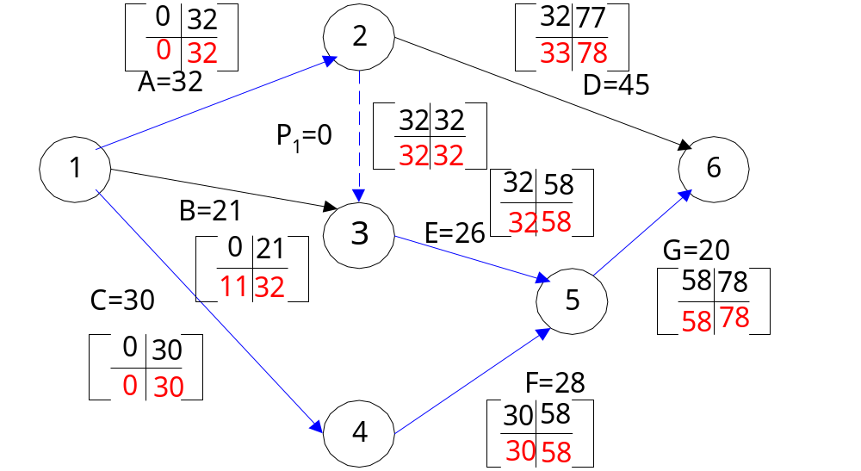
# 6
(a)
(b)
CP => A→ E→ G (78)
C→ F→G (78)

Slide 10
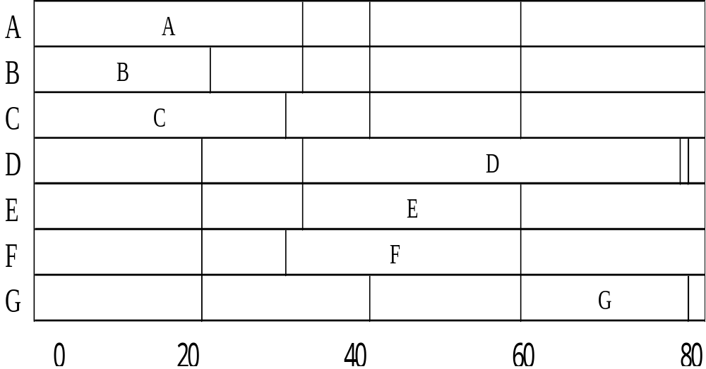
# 6
(c)
32
77
78
30
58
(d)
{ A , B , C , E , F }

Slide 11
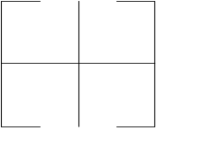
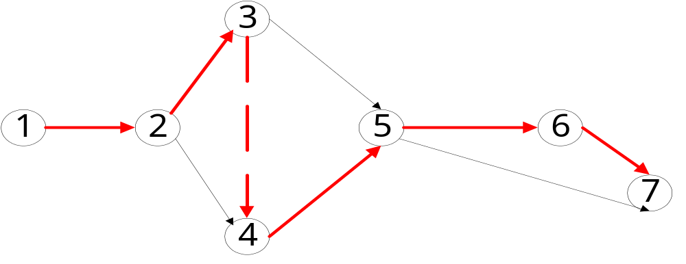
# 8
8
11
3
8
9
12
0
3
3
8
12
15
B=5
E=3
15
17
0
3
12
15
P=0
15
17
A=3
F=3
8
8
G=2
C=1
8
8
D=4
H=4
3
4
8
12
12
16
7
8
8
12
13
17
A-B-P-D-F-G

Slide 12
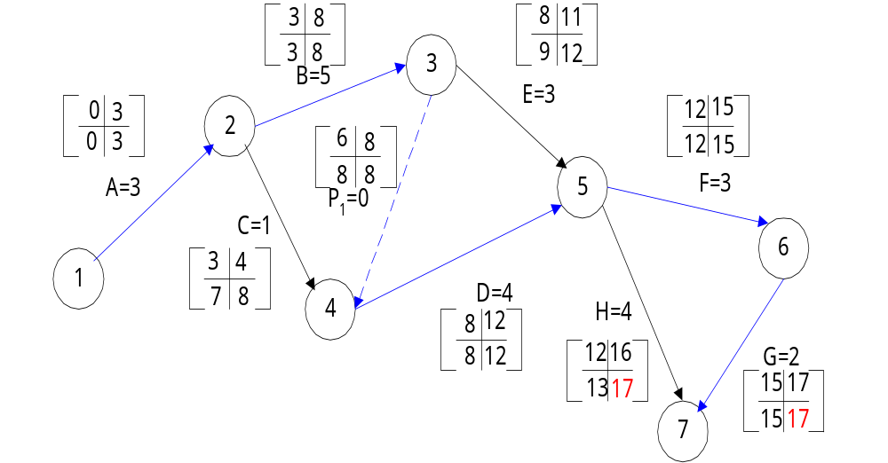
# 8

Slide 13
# 8
A
B
C
D
E
F
H
G
0
1
2
3
4
5
6
7
8
9
10
11
12
13
14
15
16
17
18
=> Where
is not needed for solution ,
but it is the slack time.

Slide 14
# 8
(a)
17
A
B
D
F
G
3
5
4
3
2
2
3
2
2
1
$ 50
125
125
120
100
*
*
‧
A 3→2 costs $50
G 2→1 costs $100
Reduce
Total $150
CP︰ A-B-D-F-G
A-B-D-H

Slide 15
# 8
(a)
15
A
B
D
F
G
H
2
5
4
3
1
4
2
3
2
2
1
2
－
$125
125
120
－
150
*
* If we consider “F” then we must
consider “H” along with “F” .
(why ?)
B by 2
D by 1
‧
Reduce
(why not 2 ?)
(refer to Gantt Chart)

Slide 16
# 8
(a)
cost $125*2 (B)
$125*1 (for D)
CP︰ A-B-D-F-G
A-B-D-H
A-B-E-F-G
A-B-E-H
Total︰$375
Time
CP
Activities
Courent
time
Expedited
time
cost
12
A
B
D
E
F
G
H
2
3
3
3
3
1
4
2
3
2
2
2
1
2
－
－
$125
50
120
－
150

Slide 17
# 8
(a)
One can consider D&E for $175/wk or F&H for $270/wk.
＞ return $150 per weak.
#
(b)
Activity
Normal cost
A
B
C
D
E
F
G
H
$200
600
100
650
450
500
500
600

Slide 18
# 8
(b)
Direct cost
$3600 for 17 days.
For 12 days optimal project schedule
Add
A
G
B
D
1
1
2
1
$50 = 50
$100 = 100
$125 = 250
$125 = 125
$525
Direct cost
$3600+$525 = $4125 for 12 days.
Indirect cost
$150*12 = $1800
Total costs = $5925.vs.$6150
#

Slide 19
# 10
(a)
‧
‧
‧
‧

Slide 20
# 10
(b)
Activities
ti
ES
EF
LS
LF
Slack
A
B
C
D
E
F
G
－
－
－
A
A，B
C
E，F
32
21
30
45
26
28
20
0
0
0
32
32
30
58
32
21
30
77
58
58
78
0
11
0
33
32
30
58
32
32
30
78
58
58
78
0
11
0
1
0
0
0
A-P₁-E-G
C-F-G
CP=

Slide 21
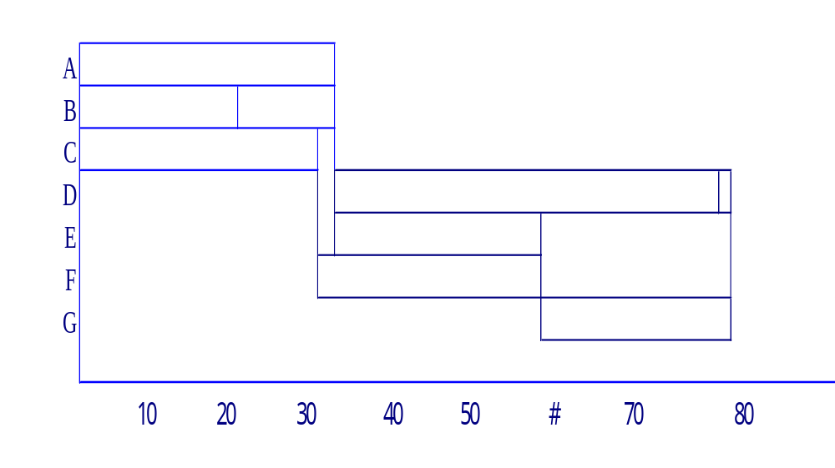
# 10
： A-E-G :CP
： C-F-G :CP
： A-D

Slide 22
# 10
Time
Act.
Current
Exp.-time
cost/dy
78
A-E-G
C-F-G
A
C
E
F
G
32
30
26
28
20
26
30
20
24
18
$50
－
110
40
75
*
‧Reduce G one day cost $75.
CP： A-D*
A-E-G
C-F-G

Slide 23
# 10
Time
Act.
Current
Exp.-time
cost/dy
77
A-D
A-E-G
C-F-G
A
C
D
E
F
G
32
30
45
26
28
19
26
30
40
20
24
18
$50
－
60
110
40
75
*
*
‧Reduce A & F by 4 day cost $90*4= $360.

Slide 24
# 10
Time
CP
Activities
Current
Exp.-time
cost
73
A-D
A-E-G
C-F-G
A
C
D
E
F
G
28
30
45
26
24
19
26
30
40
20
24
18
$50
－
$60
$110
－
$75
DONE﹗
Original 78 days cost $3300+ $100(78)= $11,100
New expedited project scheduce 73 days.
Cost Direct cost +75+360= $3735
Indirect 73*$100= $7300
Total：$11,035.

Slide 25
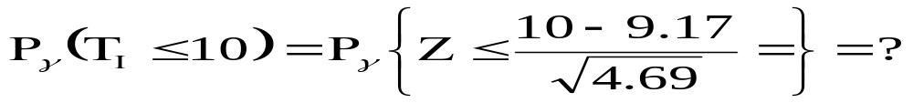
# 18
P_{r}﹛T_{I} ≦ ( 25 – 15 ) = 10﹜= ?
E (T_{I}) = 9.17
Var (T_{I}) = 4.69
( P.530 )
P_{r}﹛Z ≦0.383﹜=( 0.50+0.1492) =0.649

Slide 26
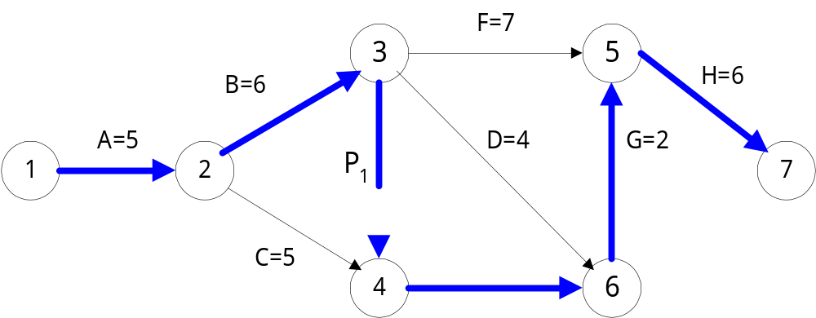
# 19
(a)
E=6
By lnspection CP => A → B → E → G → H (25)

Slide 27
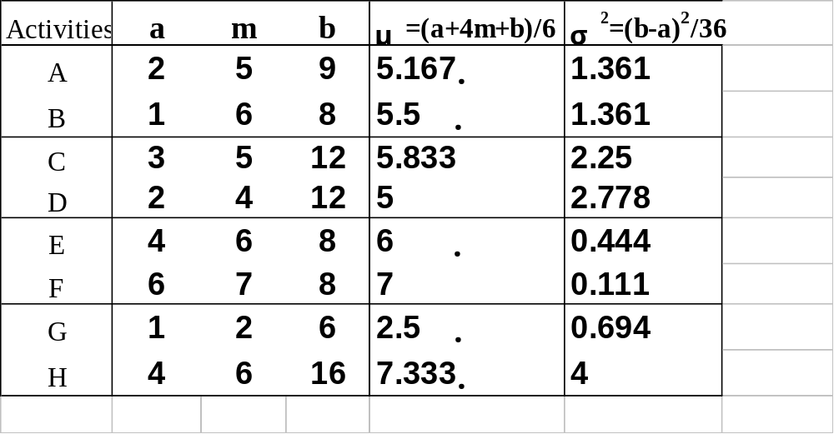
# 19
(b)
Pr{ T≦28 weeks| CP=ABEGH }=？
Pr{ T≦32 weeks| CP=ABEGH }=？

Slide 28
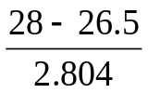
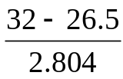

# 19
A → B → E → G → H Length = 26.5
Σσ²_{A-B-E-G-H}=7.860 => σ=2.804
Pr{Z≦ =0.535}=0.7037= 70.37﹪
Pr{Z≦ =1.962}=0.9751= 97.51﹪
(c)
Pr{T≦X weeks| CP=ABEGH} = 95﹪
Z≦
=1.645 ∴ X=31.11 weeks
#

Slide 29
# 20
(a)
All PATHS︰ A-C-E ︰ 14
A-D-E ︰ 10
B-D-E ︰ 12
B-F-G ︰ 15
A-F-G ︰ 13
(b)
B-F-G*
(c)

Slide 30
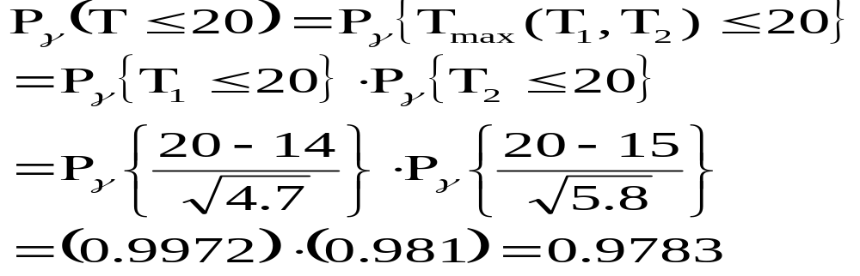
# 20
(d)
A-C-E ︰14 σ² = 4.7
B-F-G ︰15 σ² = 5.8
(e)
A-C-E ︰14, σ² =4.7
A-D-E ︰10, σ² =3.3
A-F-G ︰13, σ² =5.8
B-F-G ︰15, σ² =5.8
B-D-E ︰12, σ² =3.3
P_{r}﹛T ≦ 20﹜= (.9972)(1.000)(.9982)(.981)(1.000)
= 0.976 #

Slide 31
# 20
(f)
∵ A-C-E
B-F-G
are Independent
∴ (d) is likely to be the most accurate

Slide 32
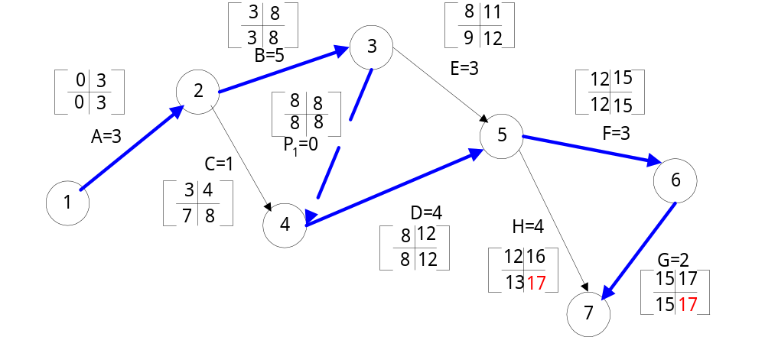
# 21
From #3
CP => A – B – D – F – G

Slide 33
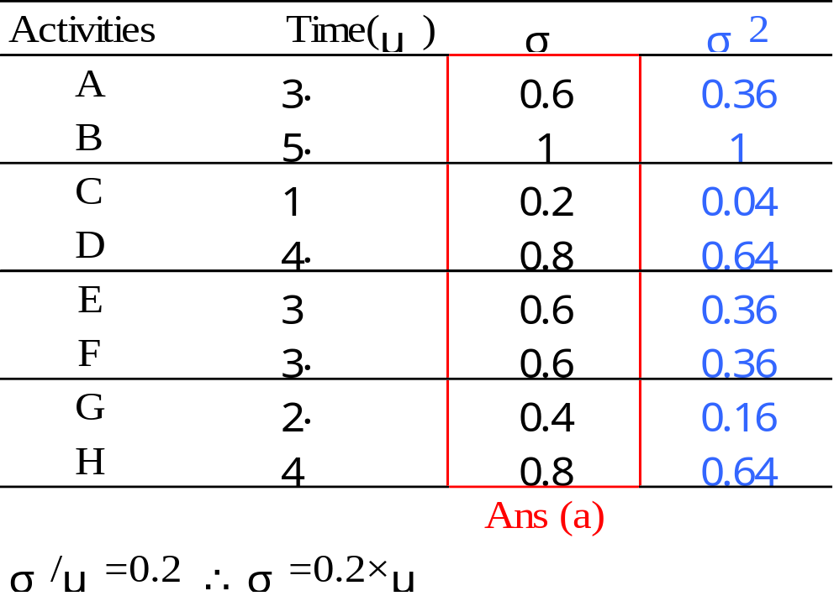
# 21
(a)
(b)
μ _{A-B-D-F-G} = 17
Ans(b)
σ ²_{A-B-D-F-G} = 2.52

Slide 34
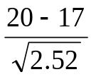
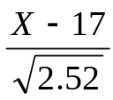
# 21
(c)
Pr{ T ≦ 20 weeks| CP=A – B – D – F – G }
= Pr{ Z ≦ =1.89}
= 0.9706
Ans(c)
(d)
Pr{ T ≦ X week}= 85%
Z = = 1.037
X =18.65(weeks)
Ans(d)

Slide 35
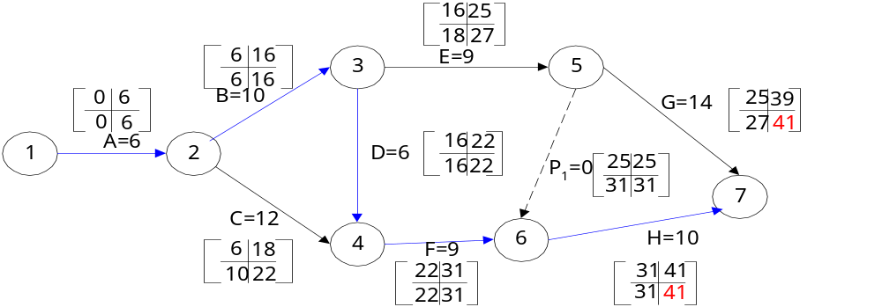
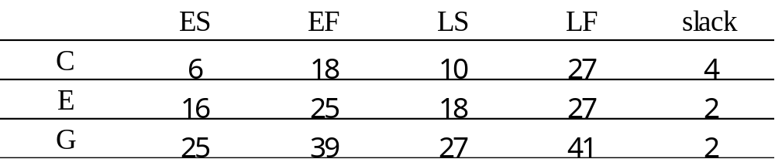
# 30
(a)
(b)
CP => A → B → D → F→ H (41 days)

Slide 36
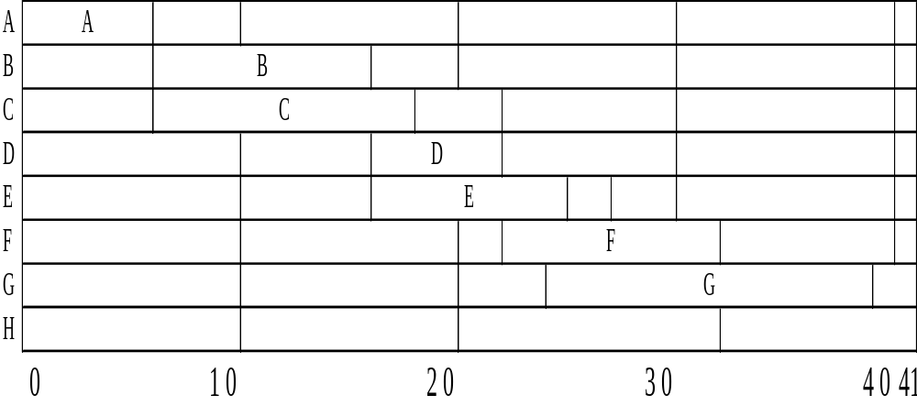
# 30
(c)
0
6
16
18
22
25
27
31
39
Indirect costs = $200 per day

Slide 37
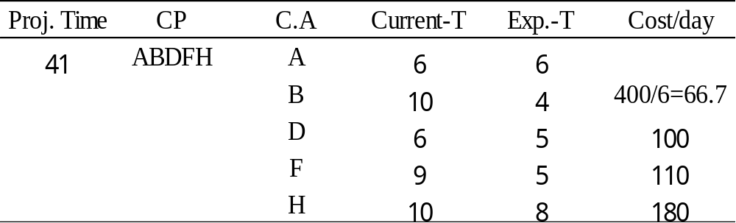
# 30
(c)
Choose B, reduce 4 days, from 10 to 6
When B+D = 6+6 =12
∴ CP = ABDFH = 37
& ACFH = 37
Cost 66.67*4 = $266.67
Save $200*4 = $800

Slide 38
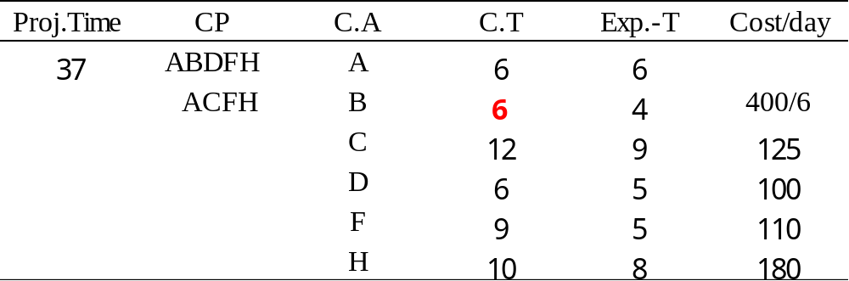
# 30
(c)
B＆C = 192； D＆C = 225；
Choose F = $110 ＜ $200 best
reduce F by 2 days, from 9 to 7
∴ CP = ABDFH =35
cost 110*2 =$220
ACFH =35
save $200*2 =$400
ABEG = 6+6+9+14=35

Slide 39
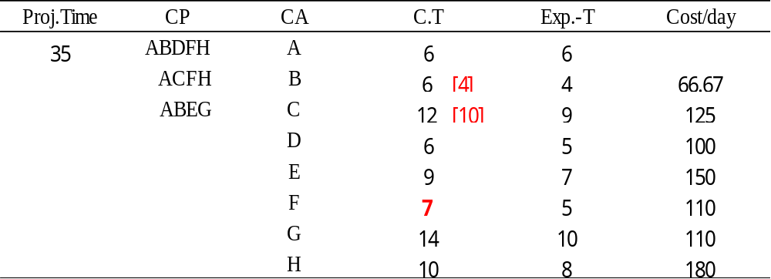
# 30
(c)
B＆C = 192＜200
by 2 day
cost 192*2 = 384
save 200*2 = 400
Total costs = 266.67+220+384 = 870.67
Savings = 800+400+400 = 1600
Net savings = 729.23

Slide 40
# 30
Original Costs
A – B – D – F – H (41)
200+600+625+700+200+400+1000+1100+[$200(41)]
=$13‚025
Original Direct $4825
Indirect $200*41
$13,025

Slide 41
# 30
Expedited Costs
Original $4825
+ Expedited Costs $267 (4*B)
220 (2*F)
384 2*(B+C)
$871
+ Indirect Costs
$200*(33) = $6600
=>Net savings $729
=>Time saved 41-33 = 8 (days)
$12,296

Slide 42
The End

